Slide 1

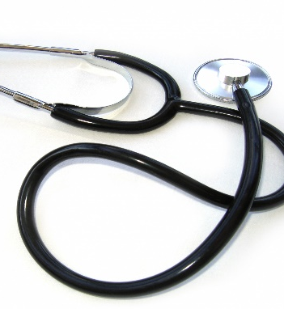
ROBO DOC
DR. HARSHA S
ASSOCIATE PROFFESOR,DEPT OF ISE
JYOTHY INSTITUTE OF TECHNOLOGY
Presented by
HARIPRIYA V JOSHI(1JT16IS016)
MEGHANA M(1JT16IS024)
SHUBHA V(1JT16IS048)

Slide 2


CONTENTS
Aim
Abstract
Literature Survey
Methodology
Data
Flow Chart
Algorithms
Outcome
User Interface
Bibliography

Slide 3

Aim
To build a system which would be effective in
predicting the protein interactions responsible
for genetic diseases. The system must be able to
predict genetic diseases based on symptoms given
and also suggests possible treatment for the predicted diseases

Slide 4

Abstract
Currently genetic disorders are identified using invasive methods which involves collecting tissues sample and analysing it which might be painful.
Many of the researches have come up with different possible solutions but still having its own drawbacks
Therefore we have come up with a better solution to avoid these drawbacks and propose a better solution.

Slide 5
Abstract
Disease classification based on protein interaction
A huge data set having multiple protein interactions and diseases caused by them would be taken as input and classified using KNN classification having class label as disease name.
Symptoms based disease classification.
Based on the symptoms ,we are going to classify the diseases and then identify the protein -protein interaction that is responsible for the diseases.
Treatment suggestions based on symptoms
The possible treatments are for the genetic diseases are identified and the best one would be suggested by the model.

Slide 6

Literature Survey
Basis of Genomics
Structure of DNA
Central dogma of DNA
Mutation that eventually cause for the evolution.
We learnt some core concepts related to genomics.

Slide 7


Literature Survey
Research papers
Considering the dataset which consist of protein-protein interaction
and the disease causing protein, these methods are used
in identifying proteins
Neighborhood
Matrix completion
Neural embedding
Considering OHMNET algorithm where each protein is different cell eventually causing different tissues behave differently and there by using the same traditional dependent methods yield wrong result.

Slide 8
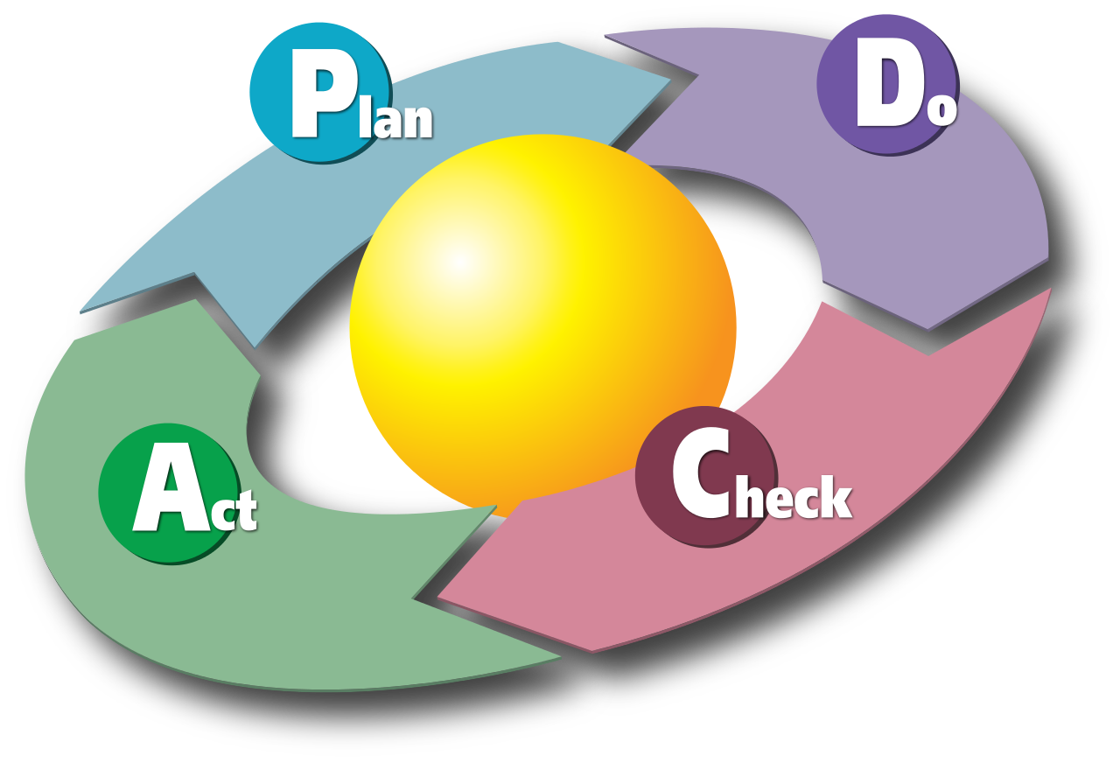
Methodology
Multiple protein interactions and diseases caused by them are taken as input and are modelled using KNN classification and Naïve Bayes having class label as disease name.
A dataset consisting of symptoms for diseases would be fed. Based on the symptoms, the diseases are classified.
The protein - protein interaction that is responsible for the diseases would be identified.
Possible treatments are identified and the best one would be suggested by the model.

Slide 9


Diseases
Carcinoma
Neoplasm
Squamous cell neoplasm
Ovarian diseases
Liver carcinoma
IGA
Obesity
Autistic Disorder
Kidney Failure
Brain neoplasm
Stomach neoplasm
prostatic neoplasm
Lymphoma
heart diseases
Schizophrenia
Rheumatoid Arthritis
Adenoid Cystic Carcinoma
salivary gland neoplasm
Diabetic Mellitus
Peripheral neuropathy

Slide 10

Data
A data consisting of 21,000 proteins having 3,21,000 interactions are considered and modelled for identifying protein interactions for 20 diseases
A Data consisting of 10 symptoms are for 20 diseases are taken along with their 11 possible treatment.

Slide 11

Flow chart
Disease prediction
Protein prediction
Treatment proposal
Symptoms
Diseases
proteins
Cross verification
Diseases
Treatment

Slide 12
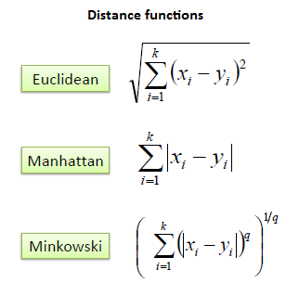
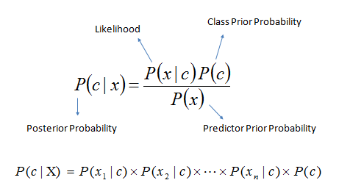
ALGORITHMS
K- nearest neighbors
Naïve Bayes

Slide 13
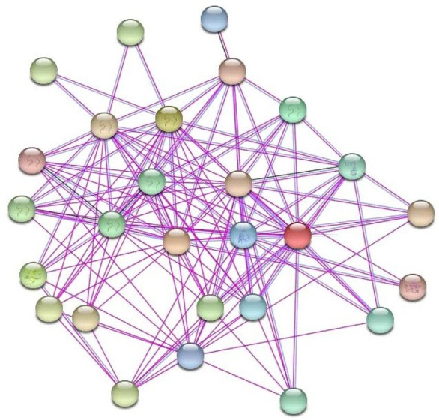
OUTCOME
Initially Naïve Bayes classifier was applied which resulted in 100% accuracy for protein disease identification and 36.6% accuracy for disease protein identification.
The result is 100% accurate for disease prediction considering diseases and shows 29% accuracy for treatment prediction.

Slide 14
OUTCOME
Later KNN classification algorithm was applied for the same data which resulted in 70% accuracy considering 2 neighbors and 400 proteins per disease.

Slide 15

Applications and Advantages
Précised diagnose system with learning capability
A detailed connectivity generated with proteins, disease symptoms and treatment.
The built model is useful by doctors to find out the
proteins responsible for the disease and come up with
a root analysis of the disease an come up with treatment
for the root of the problem than symptomatic treatment.

Slide 16

Conclusion & Future work
Apart from invasive procedures, diseases can be diagnosed using machine learning aid with better accuracy compare to any previous work.
Further work includes applying reverse engineering which can predict protein interactions considering only symptoms and propose possible treatment.
The model is built only for 20 diseases where most of them are cancer. It can be built to other genetic diseases.
This Photo by Unknown Author is licensed under CC BY-ND

Slide 17
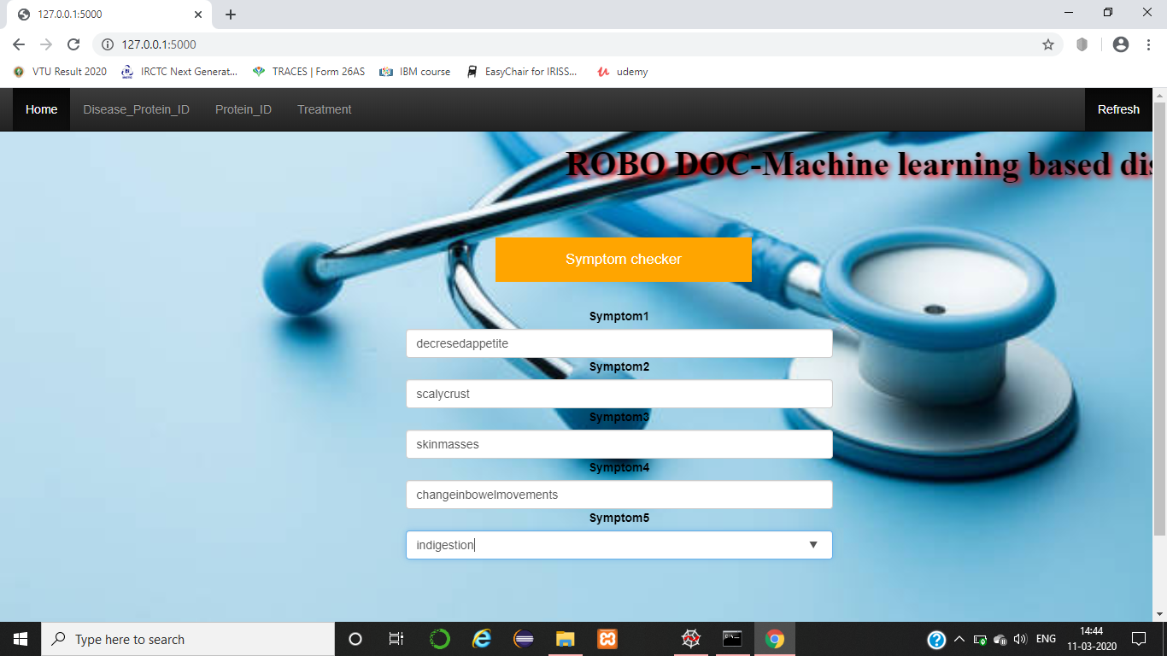
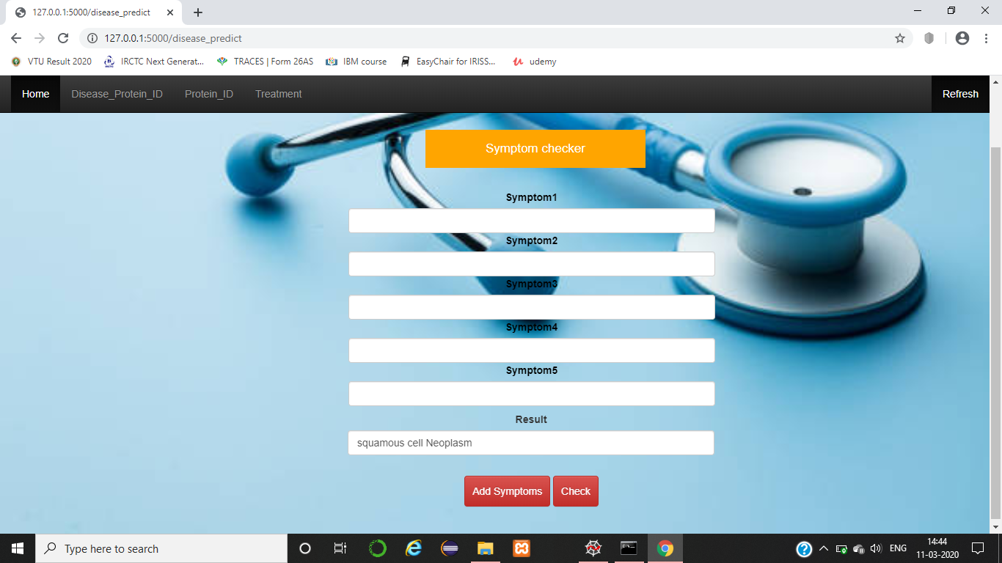
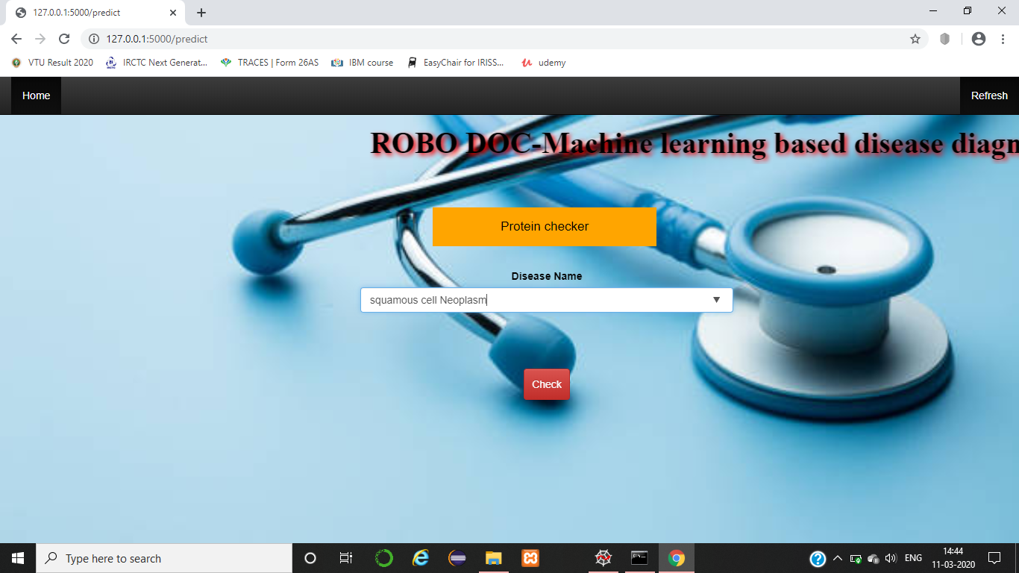
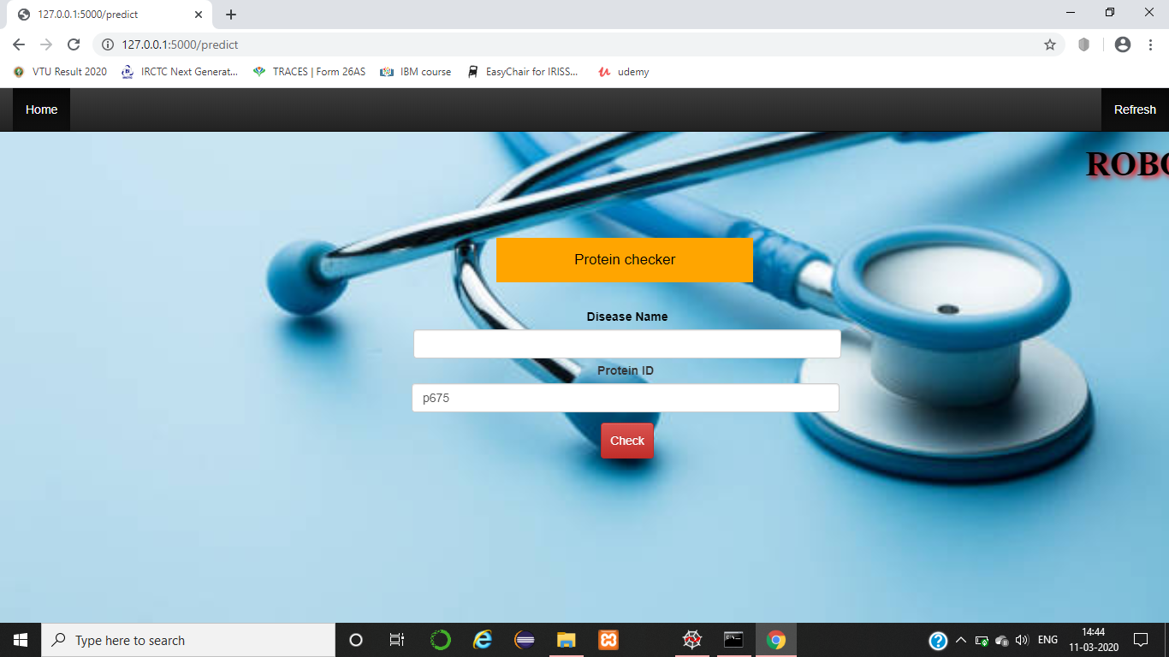
User Interface

Slide 18
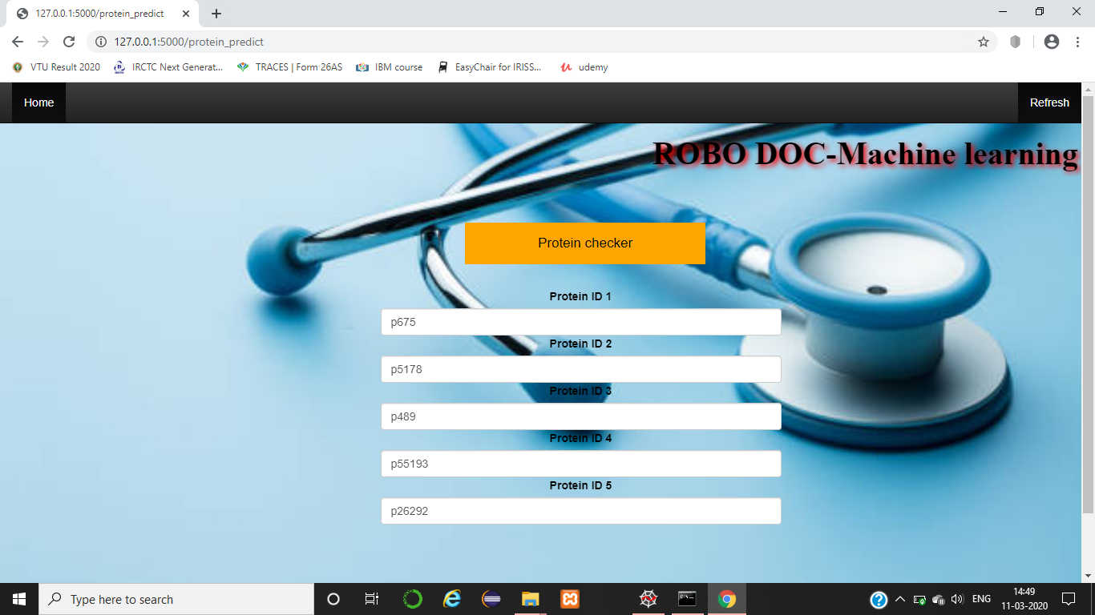
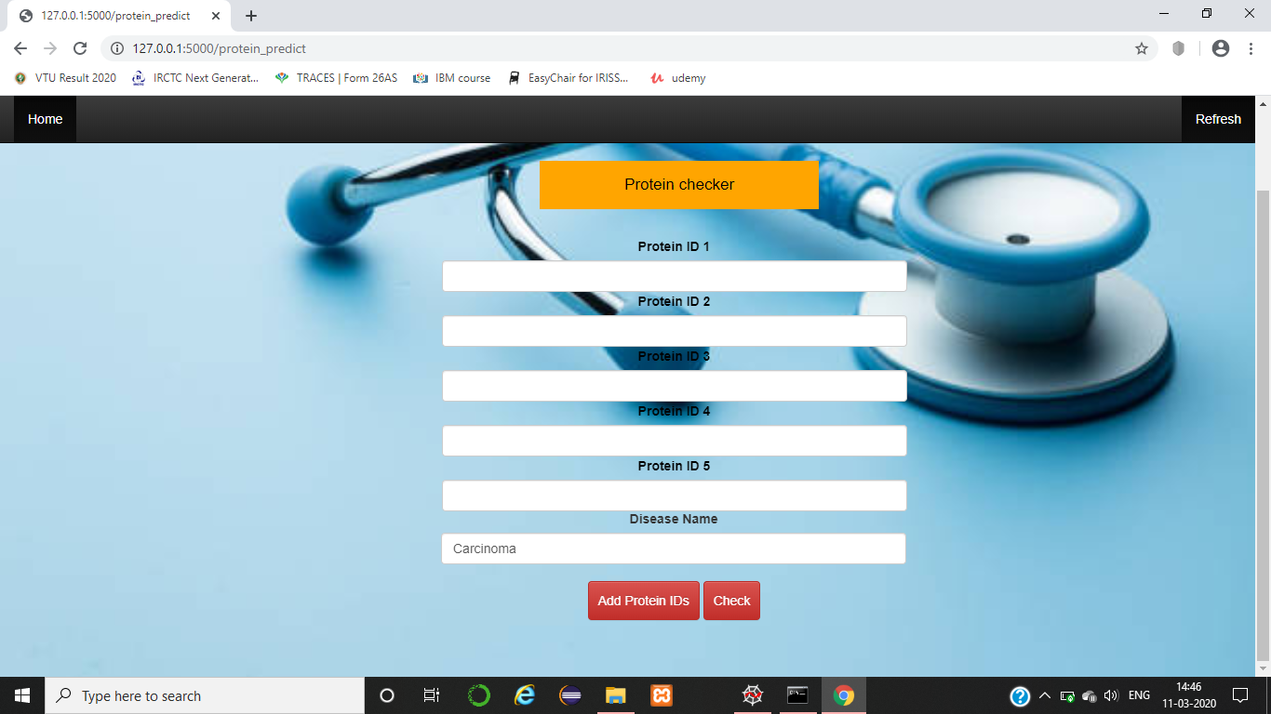


User Interface

Slide 19


Bibliography
https://www.frontiersin.org/articles/10.3389/fgene.2019.00535/full
https://cs.stanford.edu/people/jure/pubs/ohmnet-ismb17.pdf
Effective Heart Disease Prediction Using Hybrid Machine Learning Techniques-IEEE Access (Volume 7
https://web.stanford.edu/class/cs273a/cgi-bin/

Slide 20
Bibliography
https://scikitlearn.org/stable/modules/generated/sklearn.neighbors.KNeighborsClassifier.html
https://www.biorxiv.org/content/biorxiv/early/2019/01/28/532226.full.pdf
https://stringdb.org/cgi/input.pl?sessionId=ohBWzrJORQR1&input_page_show_search=on
M. D. Ritchie, E. R. Holzinger, R. Li, S. A. Pendergrass and D. Kim, Nature Reviews Genetics 16, 85 (2015).

Slide 21


